Slide 1
Sampled Dense-Dense Matrix Multiplication (SDDMM)
Yevhen Khavrona, Dumeni Manatschal, Konstantinos Stavratis, Woojin Ban, Dominic Wüst

Slide 2
Overview
1. Setup
Components, testing, data generation, benchmarking, hardware specs, compiler settings
2. Algorithms
Naive, cuSPARSE, SM-L2
3. Experiments
Outline of all performed experiments
4. Data Analysis
Methods and plots
5. Profiling
Profiling of SM-L2 using NVidia NSight

Slide 3
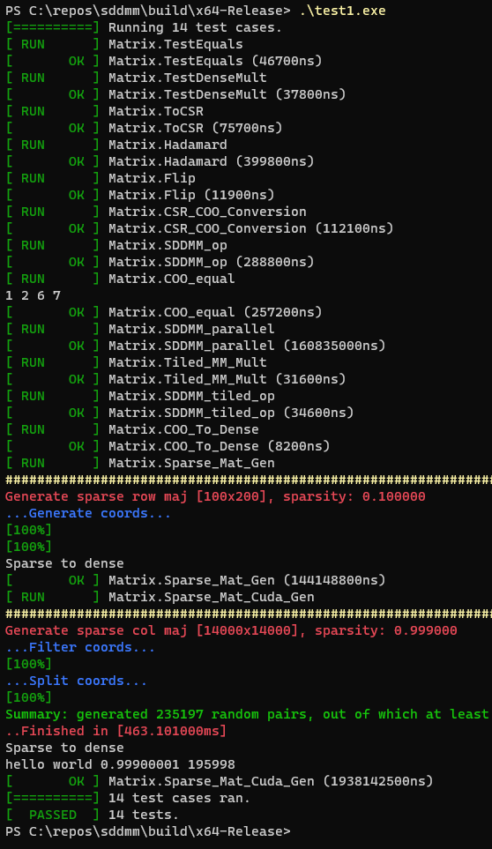
Setup I: Benchmark Components and Testing
CSR/COO/Dense
Our own implementations
Column- and Row- storage
Efficient ToFile and FromFile methods
Multiple algorithm variations
Every component tested with unit tests using UTEST
Ensuring correctness: time-consuming but top priority
https://github.com/sheredom/utest.h

Slide 4
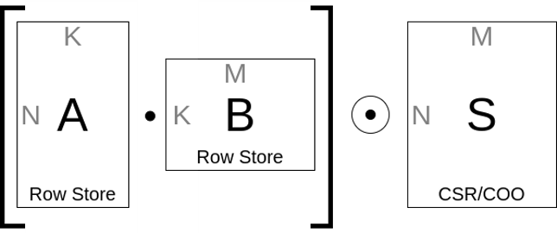
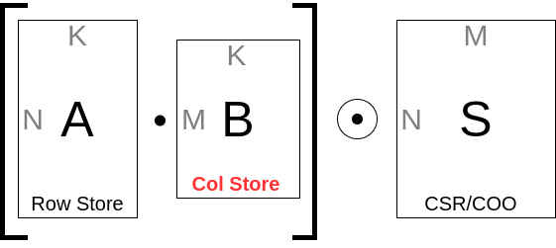
Setup II: Data Generation
Three generators for three sets of problems
1. Synthetic SDDMM: Dense A [NxK], B [KxM], Sparse S [NxM]
2. Real-world SDDMM: Dense A [NxK], B [KxM] fitting existing Sparse S
3. Real-world SDDMM Companion: Dense A [NxK], B [KxM], Sparse S [NxM]
Limitations: cuSPARSE requires sorted CSR format

Slide 5
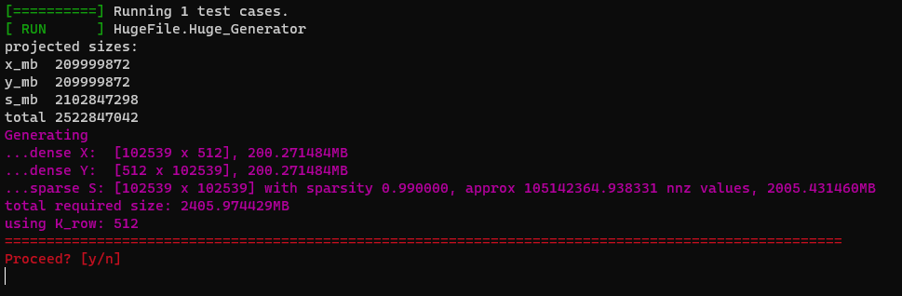
Setup II: Data Generation
Three generators for three sets of problems
1. Synthetic SDDMM: Dense A [NxK], B [KxM], Sparse S [NxM]

Slide 6
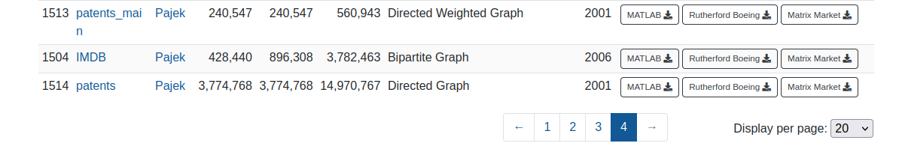
Setup II: Data Generation
Three generators for three sets of problems
2. Real-world SDDMM: Dense A [NxK], B [KxM] fitting existing sparse
https://sparse.tamu.edu/Pajek?filterrific%5Bsorted_by%5D=rows_asc

Slide 7
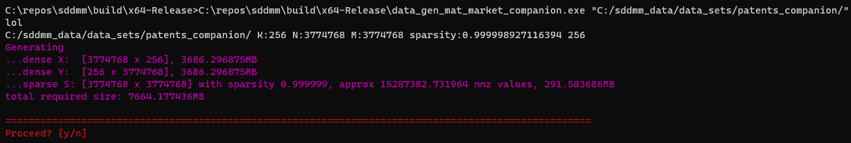
Setup II: Data Generation
Three generators for three sets of problems
3. Real-world SDDMM Companion: Dense A [NxK], B [KxM], Sparse S [NxM]

Slide 8
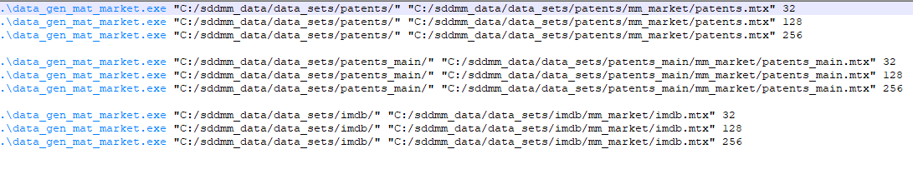
Setup II: Data Generation
All used data is stored and can be used to reproduce the experiments

Slide 9
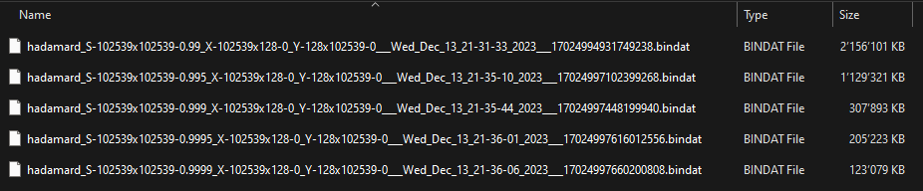
Setup III: Benchmarking Process
All used matrices are generated and stored as bindat binary files
One file contains dense A, B and sparse S in COO format
Experiment varying over 5 sparsities for fixed N, M, K includes 5 binmat files in the same folder
Experiment loader loads all files in sequence, runs all algorithms and produces benchmark output files

Slide 10
Setup IV: Hardware Specs
Benchmarking Hardware
AMD Ryzen 7 5800X, 32GB RAM
Nvidia GeForce RTX 3080, 10GB RAM, 6MB L2-cache, 49KB shared memory
Profiling Hardware
Intel Core i9-12900K, 64GB RAM
Nvidia GeForce RTX 3080Ti, 12GB RAM, 6MB L2-cache, 98KB shared memory
Operating System
Windows 11
C++ Compiler (run cl.exe without args)
Microsoft (R) C/C++ Optimizing Compiler Version 19.38.33133 for x64
/O2 /Ob2 /DNDEBUG /std:c++20
Visual Studio Community Edition 2022
Cuda Compiler (output of nvcc --version)
Built on Fri_Nov__3_17:51:05_Pacific_Daylight_Time_2023
Cuda compilation tools, release 12.3, V12.3.103
Build cuda_12.3.r12.3/compiler.33492891_0

Slide 11
Algorithms I: Overview
3 algorithms: naive, SM-L2, cuSDDMM
Our assumptions/decisions
A in row store, B in col store but not transposed
Preprocessing time for SM-L2 algo not measured
Time is measured only around the Cuda kernel using C++ chrono::high_resolution_clock from start of kernel to directly after cudaDeviceSynchronize();

Slide 12
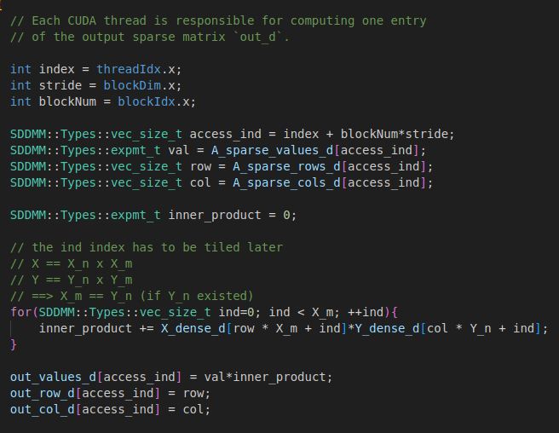
Algorithms II: Naive
Straightforward
Direct translation of the CPU code to CUDA
No tiling
No efficient data handling

Slide 13
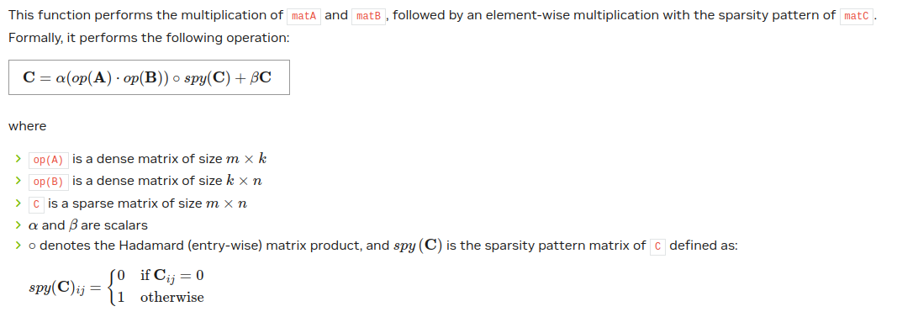
Algorithms III: cuSPARSE
NVIDIA's closed source SDDMM implementation
https://docs.nvidia.com/cuda/cusparse/

Slide 14
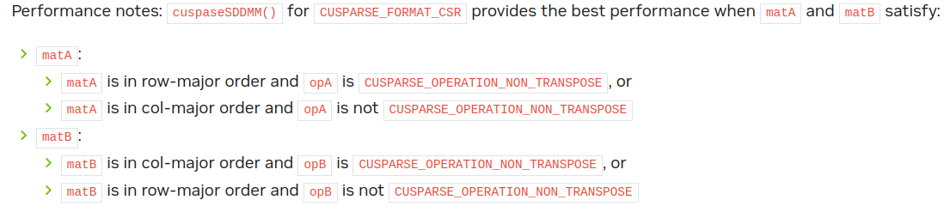
Algorithms III: cuSPARSE
NVIDIA's closed source SDDMM implementation
https://docs.nvidia.com/cuda/cusparse/

Slide 15
Algorithms IV: SM-L2
SM-L2: fast SDDMM for sample matrices with sparsity > 95%
I. Nisa, A. Sukumaran-Rajam, S. E. Kurt, C. Hong and P. Sadayappan, "Sampled Dense Matrix Multiplication for High-Performance Machine Learning" 2018 IEEE 25th International Conference on High Performance Computing (HiPC), Bengaluru, India, 2018, pp. 32-41, doi: 10.1109/HiPC.2018.00013.
Key points:
Loading only necessary ("active") rows of A into fast on-chip memory (shared memory)
Reuse of elements loaded into shared memory and L2 cache through tiling
Main technics: (3-way) tiling, vectorisation, loop unrolling, virtual warps, warp shuffling, autotuning
Kernel launch configuration: 1024 threads, roughly ½ of SM's shared memory reserved, 1 CUDA stream (sequential kernel execution)

Slide 16
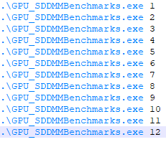
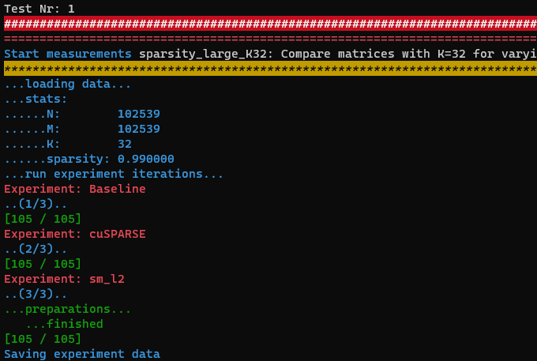
Experiments I: Overview
Varying sparsity with same dimensions N, M, K
All sparse input matrices have uniform density
Varying K with same N, M and sparsity
One series using existing sparse matrix with non-uniform distribution and produced dense matrices
One companion series with all produces inputs with uniform distribution
Reproducibility
40GB of stored matrix data
One bindat file per algorithm run
Code on GitHub

Slide 17
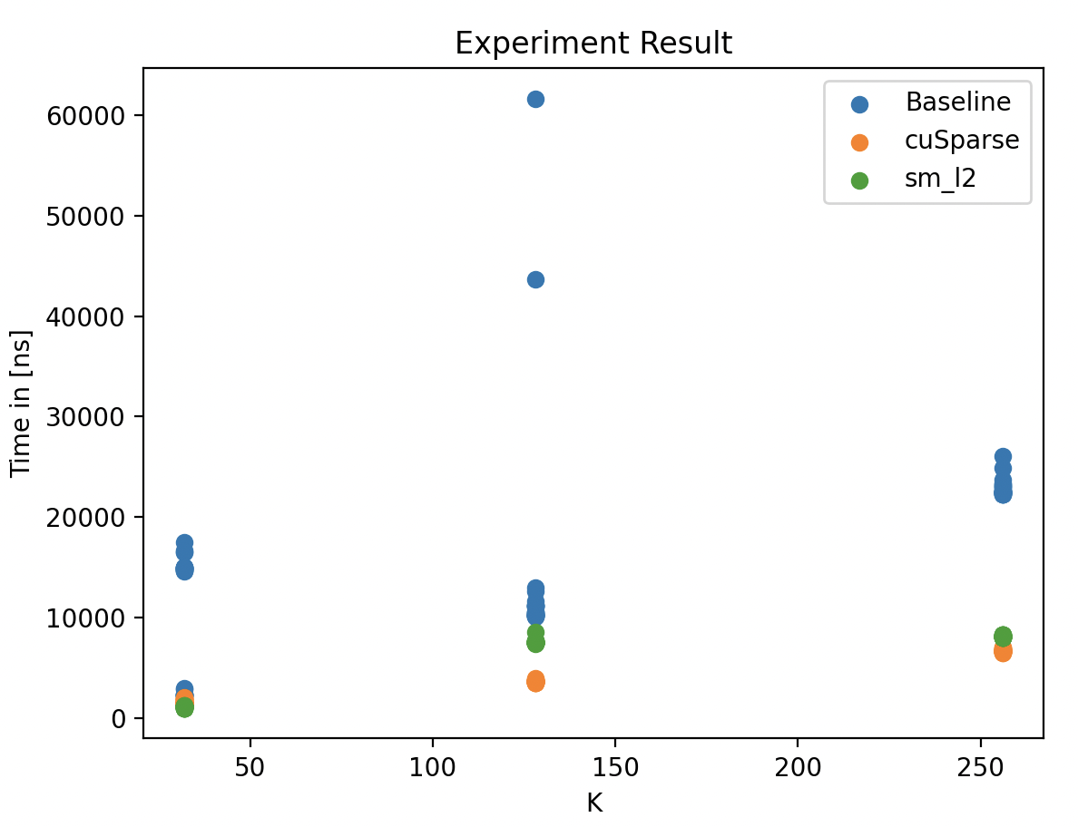
Experiments II: IMDB
IMDB
https://sparse.tamu.edu/Pajek?filterrific%5Bsorted_by%5D=rows_asc (p. 4, id: 1504)
Rows = 428,400, cols = 896,308, #nnz = 3,782,463
We measured the runtime with sparsity = 0.99999, K = 32, 128, 256 (#iterations = 30, #warm-up iterations = 5)

Slide 18
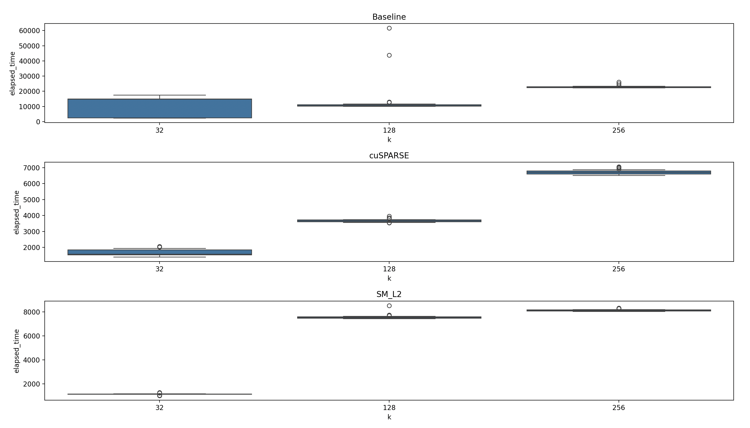
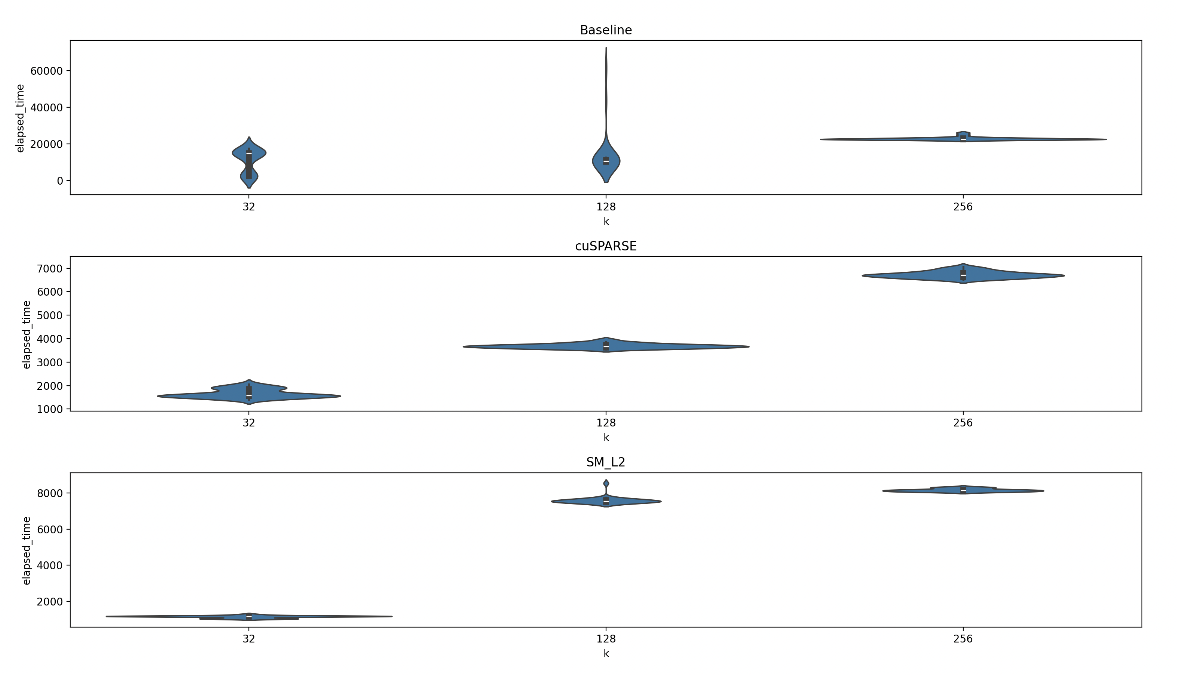
Experiments II: IMDB

Slide 19
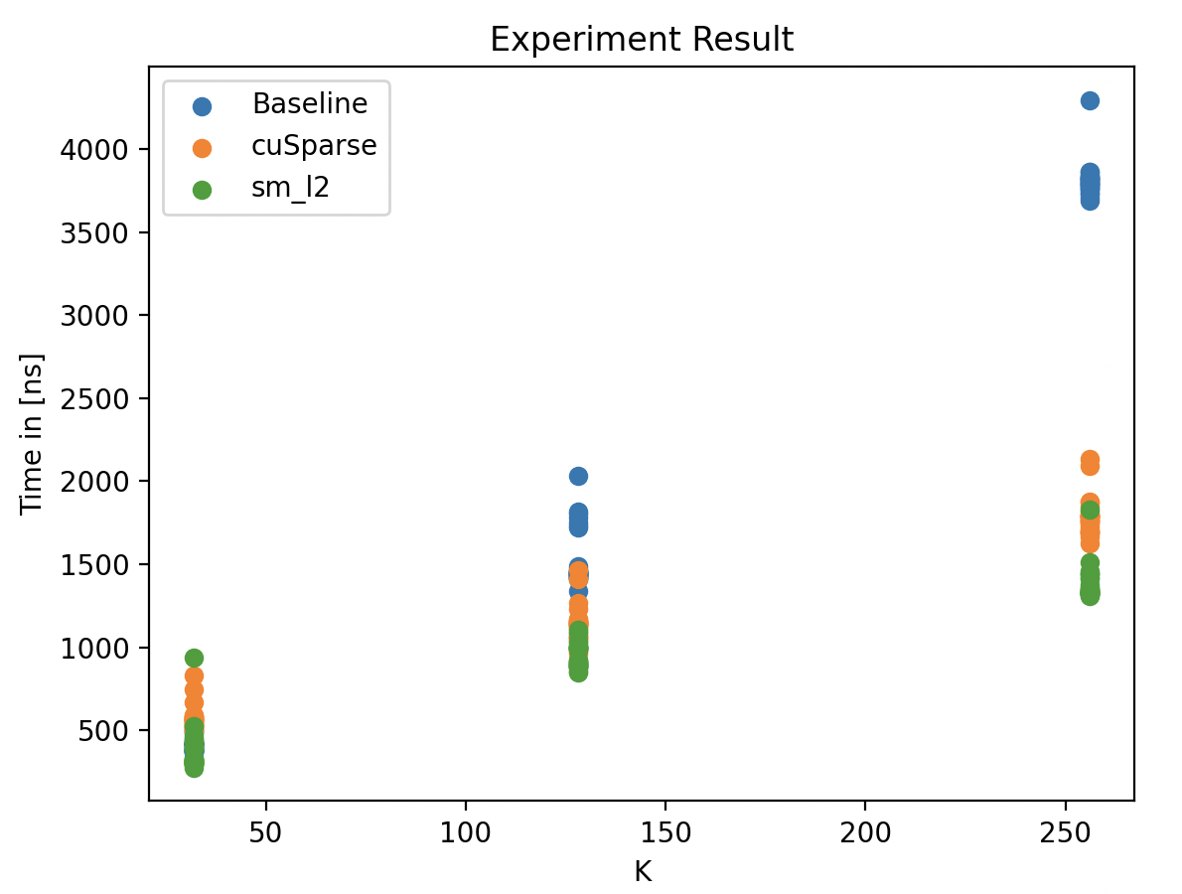
Experiments III: patents_main
Patents_main
https://sparse.tamu.edu/Pajek?filterrific%5Bsorted_by%5D=rows_asc (p. 4, id: 1513)
Rows = 240,547, cols = 240,547, #nnz = 560,943
Measurement with sparsity = 0.99999, K = 32, 128, 256 (#iterations = 30, #warm-up iterations = 5)

Slide 20
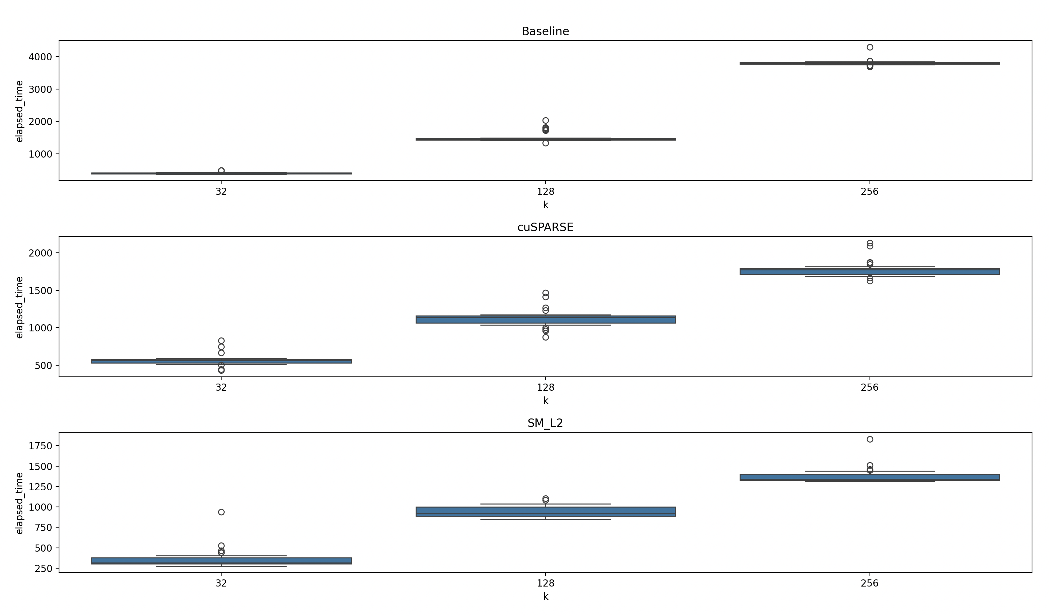
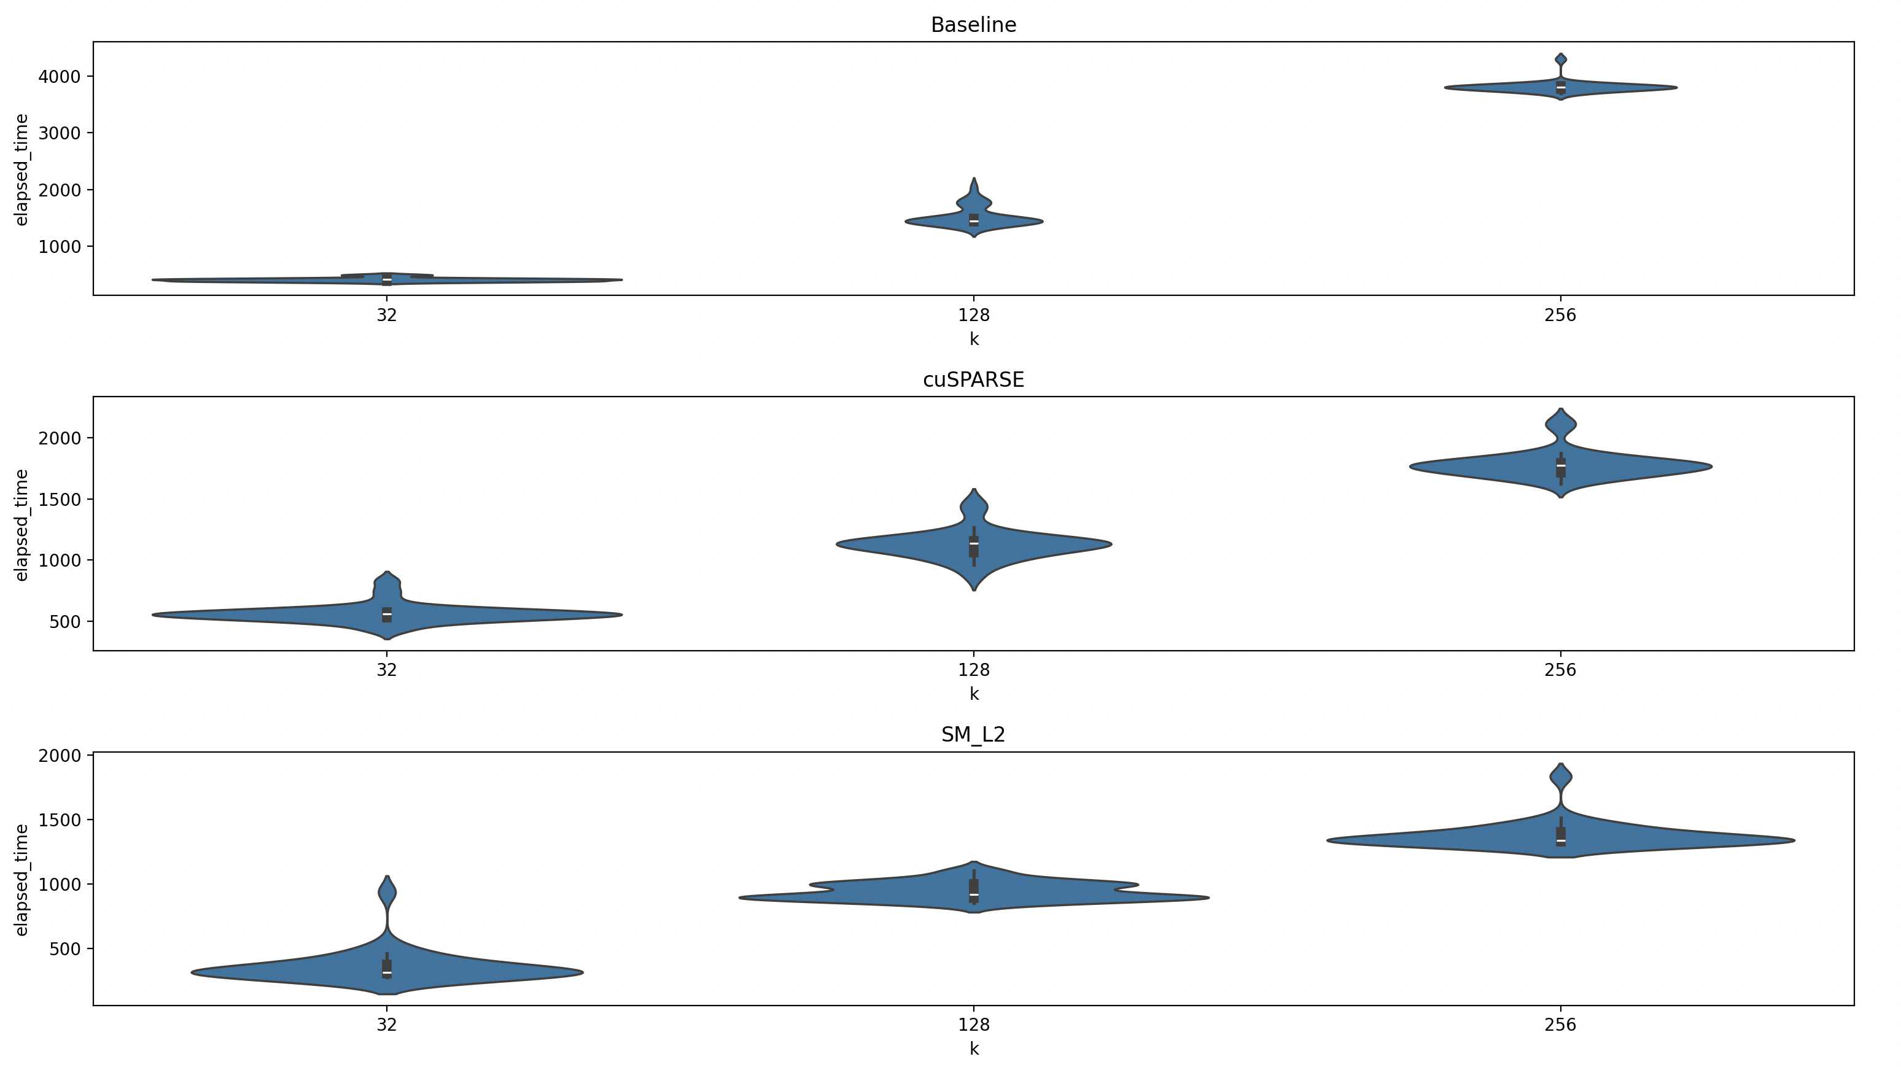
Experiments III: patents_main

Slide 21
Experiments IV: sparsity_large
N = 102539, M = 102539, K = 32, 128, 512
Large in terms of the matrix size
Varying sparsity 0.99, 0.995, 0.999, 0.9995, 0.9999
#iteration = 30, #warm_up iteration = 5

Slide 22
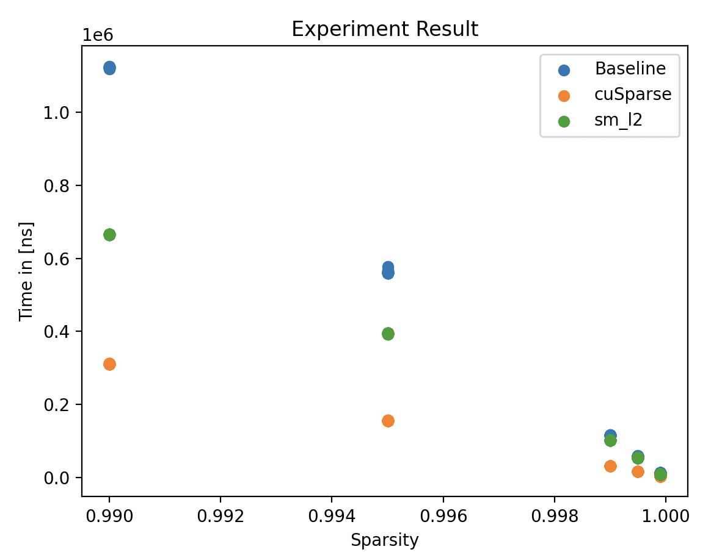
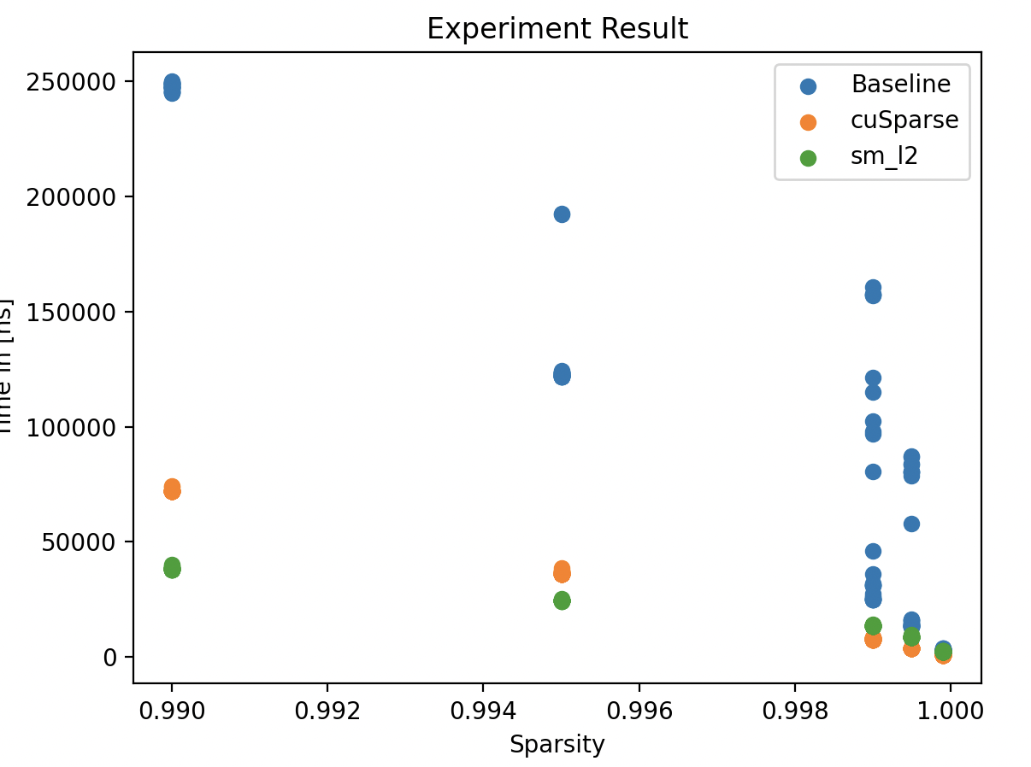
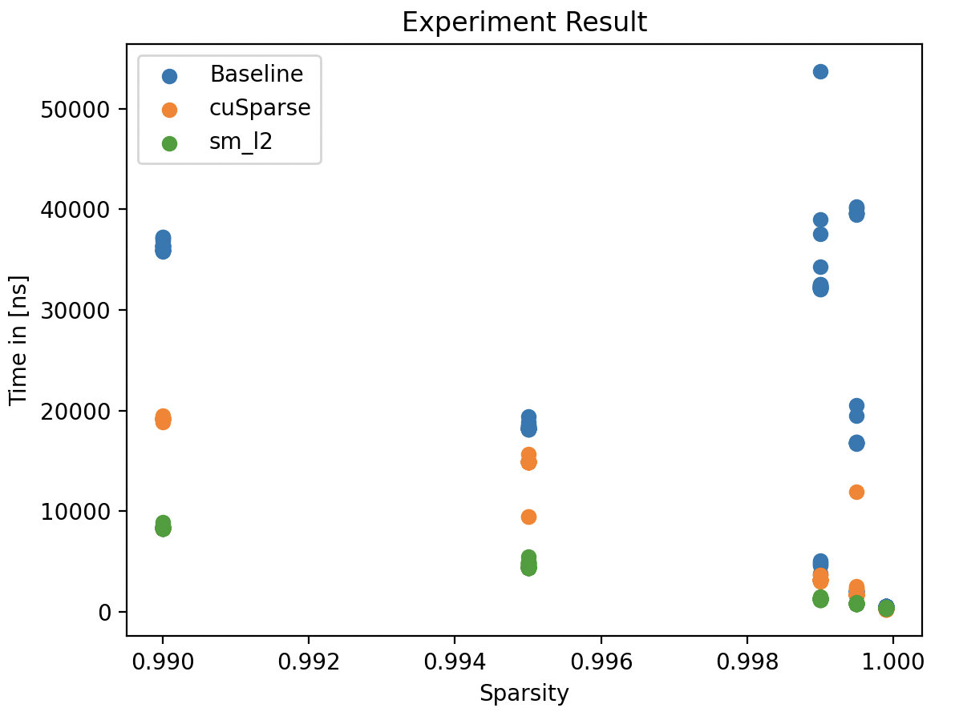
Experiments IV: sparsity_large

Slide 23
Experiments V: sparsity_small
N = 10253, M = 10253, K = 32, 128, 256
Small in terms of the matrix size
Varying sparsity 0.99, 0.995, 0.999, 0.9995, 0.9999

Slide 24
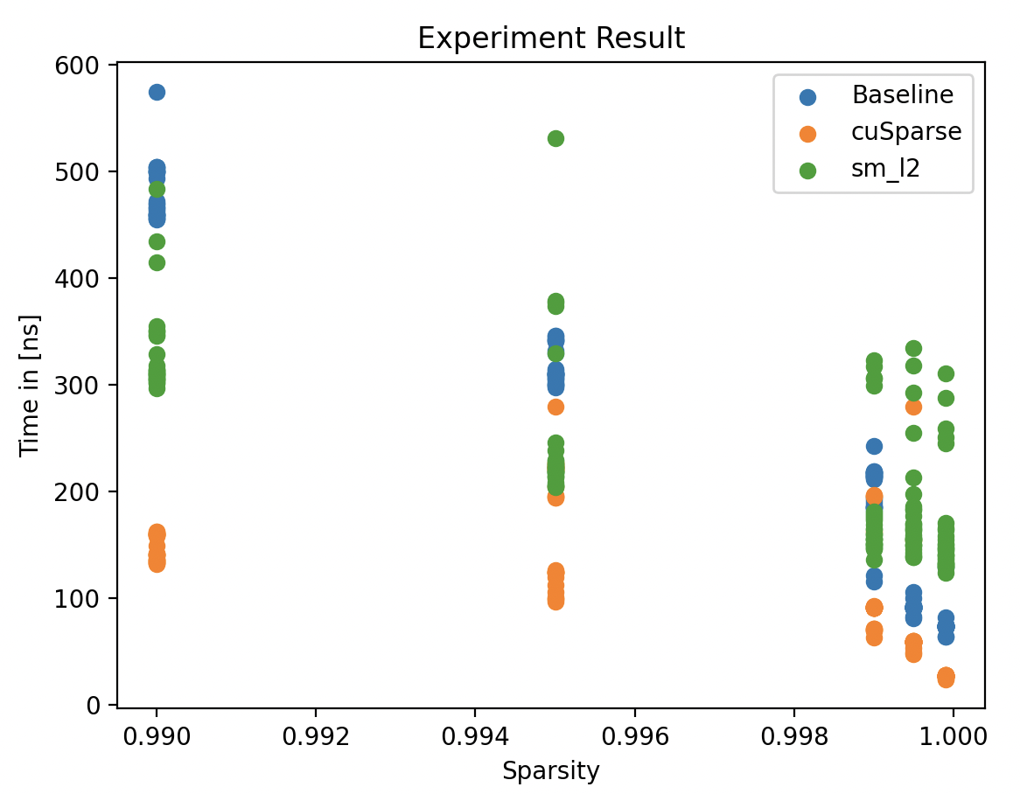
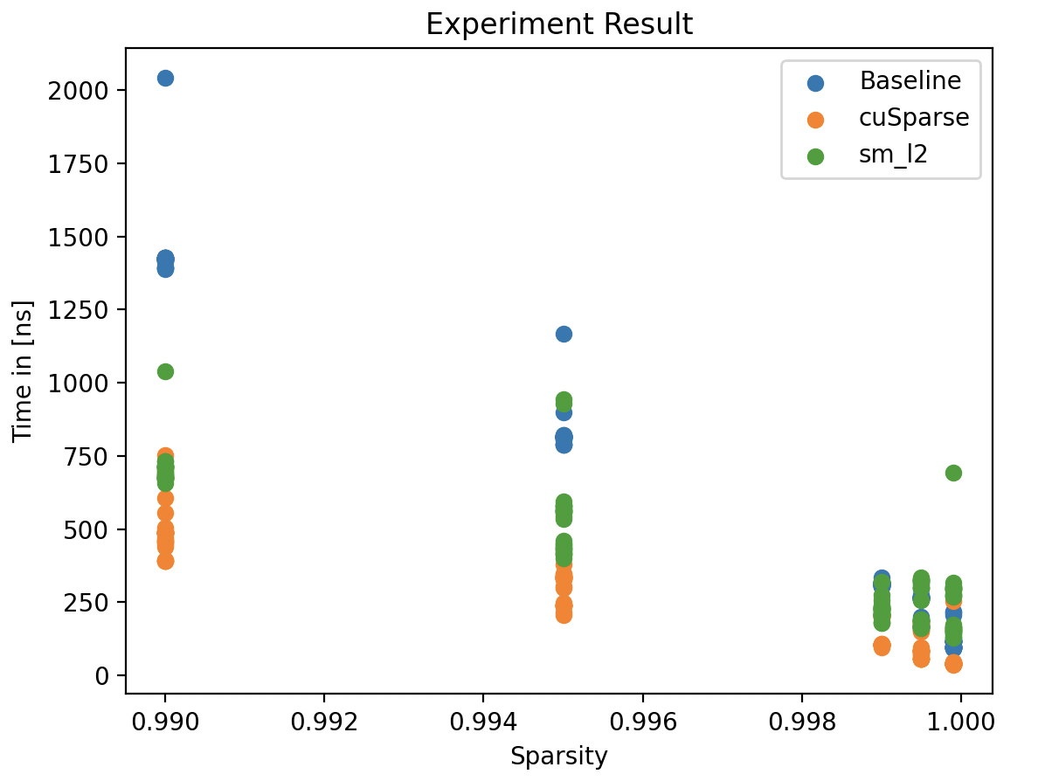
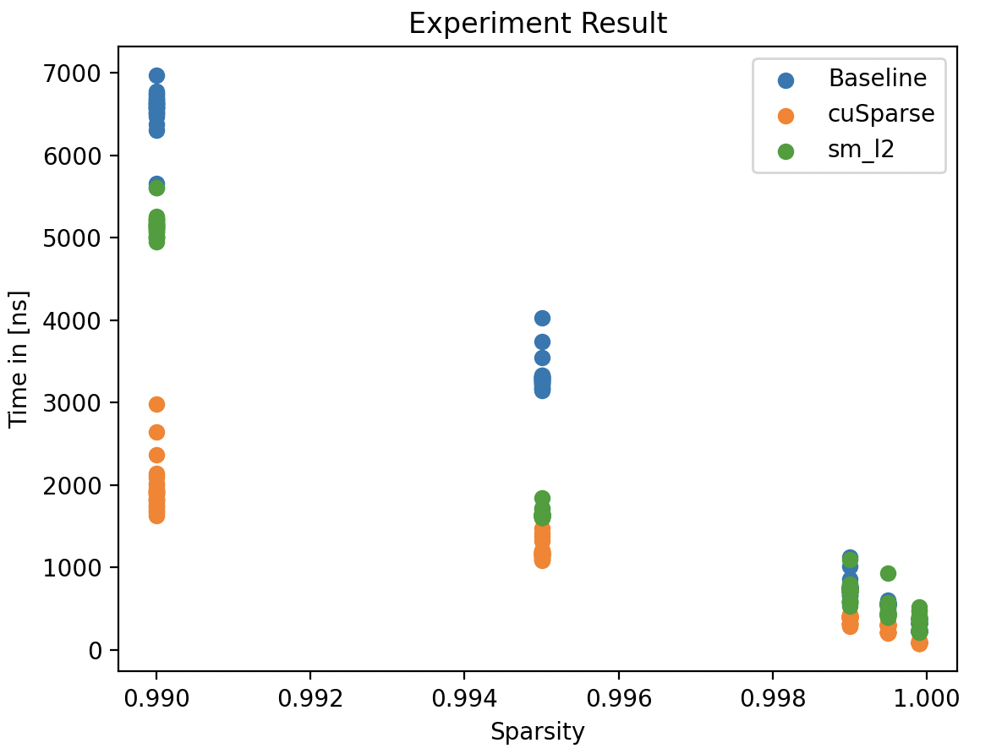
Experiments V: sparsity_small

Slide 25
Experiments VI: Conclusion
We measured baseline, cuSparse and sm_l2 on various datasets such as IMDB, IMDB_companion, patents, patents_companion, patents_main, patents_main_companion with different K and fixed matrix size with varying sparsity
For K=32, sm_l2 is superior to baseline and cuSparse (in all datasets and with varying sparsity except for sparsity with small matrix size)
From K=128, cuSparse is superior to sm_l2 and baseline

Slide 26
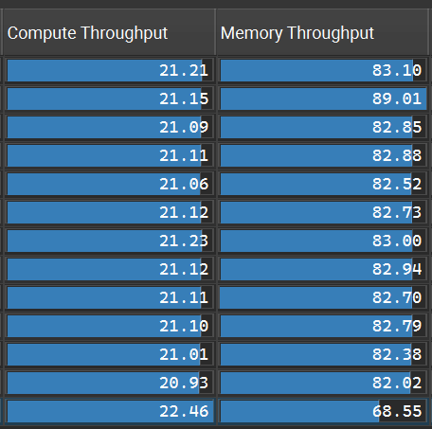
Profiling SM-L2 I: Overview
NVIDIA Nsight Compute
Input: N=M=100K, sparsity = 0.99
Results in 13 kernel invocations,
each launching 268 threadblocks

Slide 27
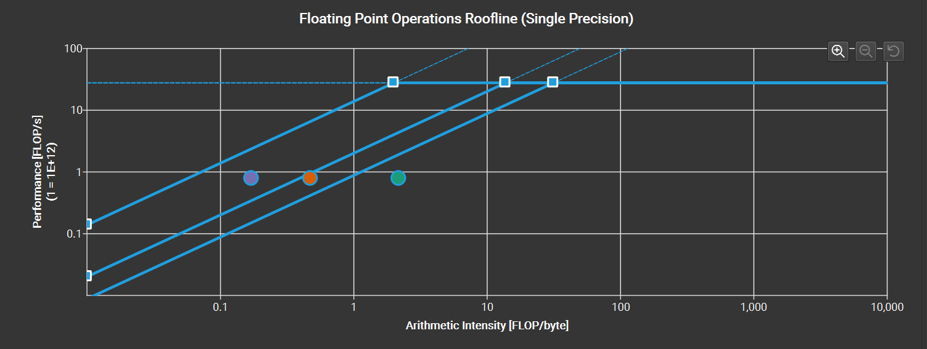
Profiling SM-L2 II: Observations
Memory bound, L2 (red dot) saturated, low "compute" utilisation
Uncoalesced global memory accesses
Occupancy limited by the number of required registers
High on-chip memory usage (register file and shared memory)

Slide 28
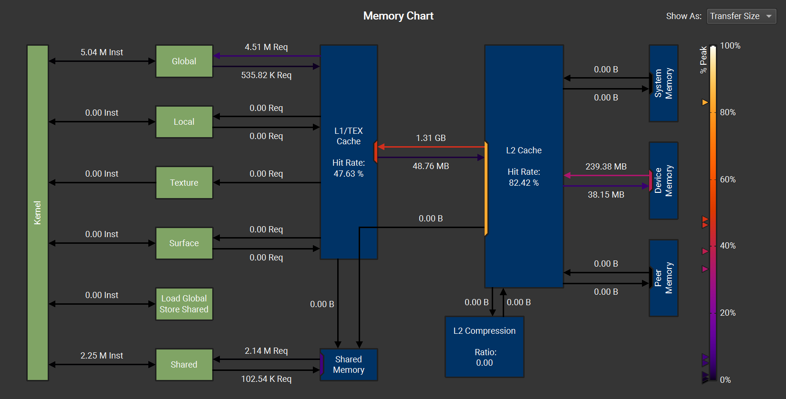
Profiling SM-L2 III: Memory
Main hotspot

Slide 29
